Slide 1
Weekly report: Foundations
Week number: 8
Date: 18/11/2025
Supervisor: Prof. Dr.-Ing. Torsten Faber
Group members : Jehad Albaali- Amgad Gerges - Reda Deif
presented by : Reda Deif

Slide 2
List of contents
Check punching shear stress
Group members: Jehad Albaali- Amgad Gerges - Reda Deif
Foundations team/ Optimus Syria

Slide 3
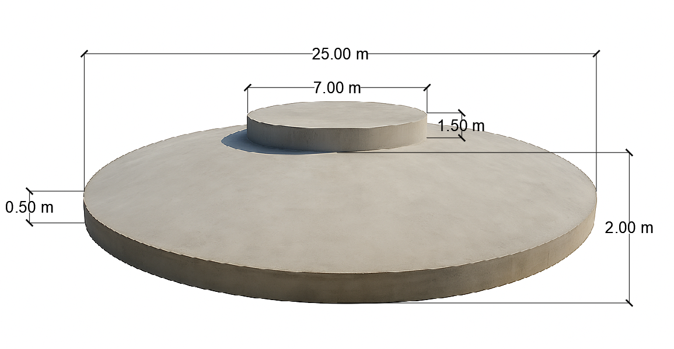
Concrete Dimensions
Diameter of Base Plate (BP) = 25 m
Diameter of Pedestal = 7 m
Height Pedestal = 1.5 m
Height of Middle slab = 2 m
Height of Frustum (HF) = 1.5 m
Height of Edge slab (HE) = 0.5 m
Group members: Jehad Albaali- Amgad Gerges - Reda Deif
Foundations team/ Optimus Syria

Slide 4
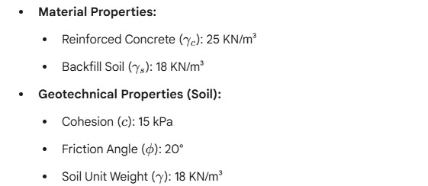
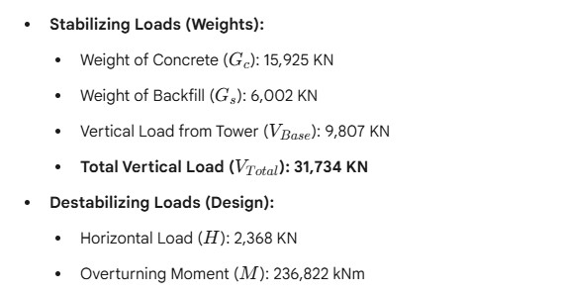
Input data
Group members: Jehad Albaali- Amgad Gerges - Reda Deif
Foundations team/ Optimus Syria

Slide 5
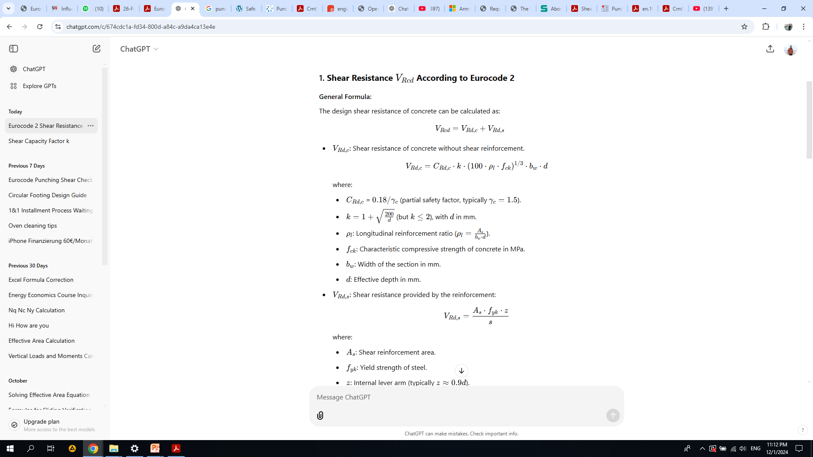
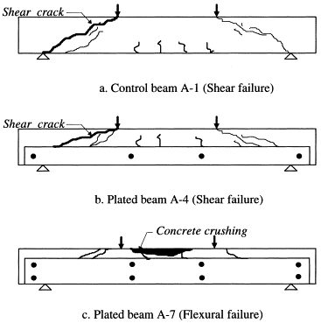
Design of Raft for bending moment
VRd,c​ = 0.12 * 1.32 * (100 * 0.00182 * 30 )^1/3 *1000 *1950
:
Reference
VRd,c
EN 1992 – Eurocode 2: Design of Concrete Structures
= 0.54 N/mm2
Group members: Jehad Albaali- Amgad Gerges - Reda Deif
Foundations team/ Optimus Syria

Slide 6
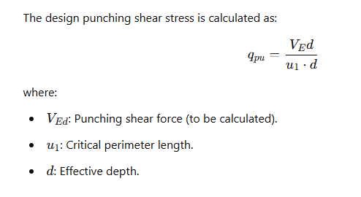
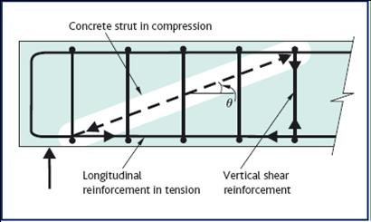
Moment per unit width at foundation edge
Reference :
Concrete grades according to EC 2 and DIN 1045-1 (2008)
EN 1992 – Eurocode 2: Design of Concrete Structures
Group members: Jehad Albaali- Amgad Gerges - Reda Deif
Foundations team/ Optimus Syria

Slide 7
Reinforcement Calculation
$q_{pu}=\frac{31,734∗10^3}{47,123⋅1950}$ = 0.34 N/mm
V Rdc > q pu
Safe
Group members: Jehad Albaali- Amgad Gerges - Reda Deif
Foundations team/ Optimus Syria

Slide 8
Time Schedule Planning
Time Schedule Planning
Week 1-2: Data Collection & Project Kick-off
Week 3-4: Geotechnical Analysis & Conceptual Design
Week 5-7: Detailed Design & Verification
Week 8-9: Structural Design (Rebar & Shear)
Week 10-11: Final Drawings & Documentation
Week 12: Final Review & Submission
Group members: Jehad Albaali- Amgad Gerges - Reda Deif
Foundations team/ Optimus Syria

Slide 9
Next Tasks
Final Drawings
Group members: Jehad Albaali- Amgad Gerges - Reda Deif
Foundations team/ Optimus Syria

